Slide 1
Network Layer

Slide 2
communication at the network layer is host-to-host (computer-to-computer).
The packet transmitted by the sending computer may pass through several LANs or WANs before reaching the destination computer.
For this level of communication, we need a global addressing scheme; we called this logical addressing

Slide 3
IPv4 ADDRESSES
An IPv4 address is a 32-bit address that uniquely and universally defines the connection of a device (for example, a computer or a router) to the Internet.
An IPv4 address is 32 bits long.
IPv4 addresses are unique. They are unique in the sense that each address defines one, and only one, connection to the Internet.
Two devices on the Internet can never have the same address at the same time.

Slide 4


The address space of IPv4 is 2³² or 4,294,967,296.
Dotted-decimal notation and binary notation for an IPv4 address

Slide 5
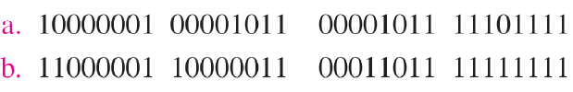

Change the following IPv4 addresses from binary notation to dotted-decimal notation.
Solution

Slide 6

Solution

Slide 7
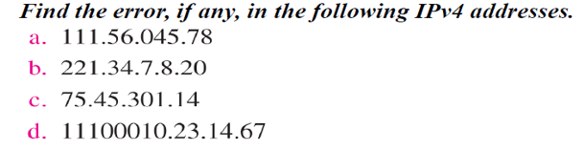
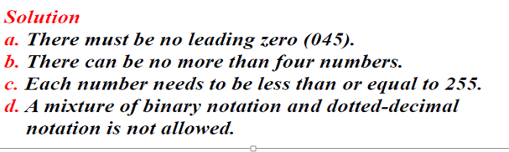

Slide 8
Classful Addressing
IPv4 addressing, at its inception, used the concept of classes.
In classful addressing, the address space is divided into five classes: A, B, C, D, and E. Each class occupies some part of the address space.
We can find the class of an address when given the address in binary notation or dotted-decimal notation.
If the address is given in binary notation, the first few bits can immediately tell us the class of the address.
If the address is given in decimal-dotted notation, the first byte defines the class.

Slide 9
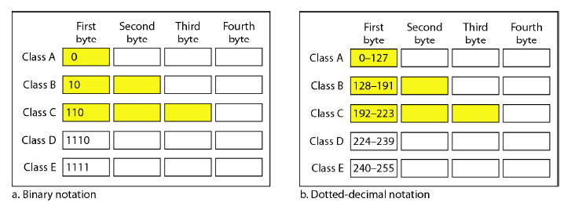
Finding the classes in binary and dotted-decimal notation

Slide 10
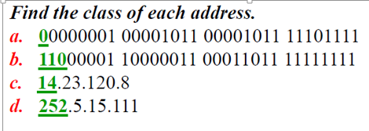
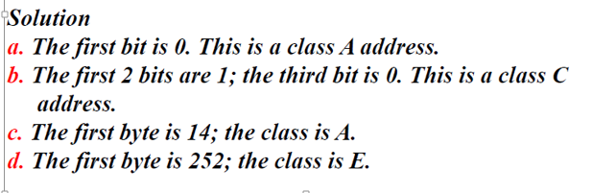

Slide 11
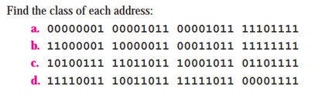
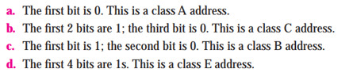

Slide 12
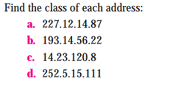


Slide 13
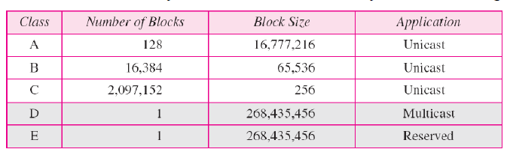
Number of blocks and block size in classful IPv4 addressing

Slide 14
Netid and Hostid
In classful addressing, an IP address in class A, B, or C is divided into netid and hostid.
These parts are of varying lengths, depending on the class of the address.
In class A, one byte defines the netid and three bytes define the hostid.
In class B, two bytes define the netid and two bytes define the hostid.
In class C, three bytes define the netid and one byte defines the hostid.

Slide 15
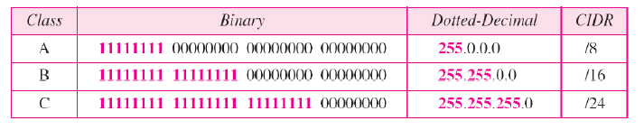
Mask
Although the length of the netid and hostid (in bits) is predetermined in classful addressing, we can also use a mask (also called the default mask), a 32-bit number made of contiguous 1s followed by contiguous 0s.
Default mask for classful addressing
The mask can help us to find the netid and the hostid. For example, the mask for a class A address has eight 1s, which means the first 8 bits of any address in class A define the netid; the next 24 bits define the hostid.

Slide 16
Subnetting
During the era of classful addressing, subnetting was introduced.
If an organization was granted a large block in class A or B, it could divide the addresses into several contiguous groups and assign each group to smaller networks (called subnets) or, in rare cases, share part of the addresses with neighbors.
Subnetting increases the number of Is in the mask.

Slide 17
Disadvantage of Classful Addressing:
Class A with a mask of 255.0.0.0 can support 16, 777, 214 addresses
Class B with a mask of 255.255.0.0 can support 65, 534 addresses
Class C with a mask of 255.255.255.0 can support 254 addresses
But what if someone requires 2000 addresses ? One way to address this situation would be to provide the person with class B network. But that would result in a waste of so many addresses. Another possible way is to provide multiple class C networks, but that too can cause a problem as there would be too many networks to handle.
To resolve problems like the one mentioned above CIDR was introduced.
Classless Inter-Domain Routing (CIDR): CIDR or Class Inter-Domain Routing was introduced in 1993 to replace classfull addressing. It allows the user to use VLSM or Variable Length Subnet Masks.
CIDR notation: In CIDR subnet masks are denoted by /X. For example a subnet of 255.255.255.0 would be denoted by /24. To work a subnet mask in CIDR, we have to first convert each octet into its respective binary value. For example, if the subnet is of 255.255.255.0. then :

Slide 18
Classless Addressing
Classless Addressing is an improved IP Addressing system. It makes the allocation of IP Addresses more efficient. It replaces the older classful addressing system based on classes. It is also known as Classless Inter Domain Routing (CIDR).
Classful addressing does not send subnet information. Efficient address-space allocation is available in classless addressing.

Slide 19
Subnetting is the process of dividing one network into smaller networks. Collectively, the smaller networks are referred to as subnetworks (or subnets),
Subnetting Increases the number of Ones(1’s ) or (borrowing )in the mask
Note : The first address in a block is normally not assigned to any devices, it is used as a network address, represents the organization to the rest of the world.
Last address is Broadcast address, will not be assigned to any nodes, broadcast address allows information to be sent to all machines on a given subnet rather than to a specific machine

Slide 20
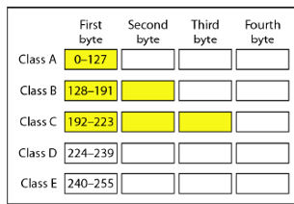
Subnetting Example
192.168.10.0/25
Find the Customised Subnet mask
Find the total number of Sub-Networks can be created
Find the Total number of IP address on each subnetwork
Find the total number of Host Address on each subnetwork
Find the Network address and broadcast address on each subnet

Slide 21
Problem 2
For the Given IP Address-192.10.10.0
Requirements :
1:Number of needed subnets-4
2:Total number of host addresses-64
3:Number of needed usable hosts-62
Find:
Address class Default subnet mask Custom subnet mask Number of bits borrowed
Find the Network address and broadcast address on each subnet

